Slide 1

Counterfeit Currency Detection Using Resource Efficient Neural Networks
SRM INSTITUTE OF SCIENCE AND TECHNOLOGY
FACULTY OF ENGINEERING AND TECHNOLOGY
DEPARTMENT OF COMPUTER SCIENCE AND ENGINEERING
15CS496L MAJOR PROJECT
Arunabha Mittra RA1611003010781
Indranil Paul RA1611003011225
Batch ID: CSE07811225
Mrs. S. Sharanya Assistant Professor (O.G)
Department of CSE
SRM-IST, Kattankulathur

Slide 2
Table of contents
Abstract
Introduction
Literature Survey
Inference from the survey
Objective of the Project
Architecture diagram
Modules Description
Novelty in Methodology
Equations, derivation and Algorithms used
Screen shot of the project
Results and Discussions
References
Publication details

Slide 3
Abstract
Counterfeiting of currency notes affects the existence of the monetary equilibrium.
Criminals continue to replicate the currency.
It attempts to provide a complete automated approach for detection of counterfeit currency notes.
This analysis helps the regulatory bodies understand what modifications could be done to improve the design.
Detailed experiments were done with real data to support the claim.
A comparative study is also done.

Slide 4
Introduction
Counterfeit money is imitation currency produced without the legal sanction of the government is fraud.
To improve existing currency detection process and make it less expensive
The intended beneficiaries of the work done is common man as they wont have to go through the long hectic process.
Can be used as the backend for web application and android/ios application.
Neural network and image processing using resource efficient neural networks is used in carrying out the project.
Data use to train model is authentic.
Certain features based on the texture and print pattern of the nodes will be studied to predict whether the particular note is counterfeit or not.

Slide 5
Literature Survey
REF. No. | OBJECTIVE | ALGORITHM USED | DATASETS OR INPUT PARAMETERS | PERFORMANCE METRICS USED | REMARK
1. | Detection of Indian Counterfeit notes using Neural Network | Image Capture Under UV light. RGB to Greyscale conversion Edge detection Feature comparison and NN efficiency calculation | Standard RBI Guidelines Indian Currency | Mean squared error rate Root mean square error rate. Peak signal to noise ratio | Cannot classify Rs 2000 note. Too complex
2. | Fake Currency detection using image processing | Image Processing K-NN SVM | Indian Currency | Edge Detection based data point mapping | SVM having better performance than K-NN

Slide 6
Literature Survey
REF. No. | OBJECTIVE | ALGORITHM USED | DATASETS OR INPUT PARAMETERS | PERFORMANCE METRICS USED | REMARK
3. | Recognition of fake currency notes using Convolutional Neural Networks | Convoluted Neural Network | Standard Google Net/Inception Dataset Le Net data set | Pre-processing Image Rescaling Using CNN | Having high efficiency loss in basic filter
4. | Machine Dating of Hand-written manuscripts | Multinomial Chi-square test. | National Library Kolkata | Probabilistic model | Sometimes practical value differs from actual value.

Slide 7
Literature Survey
REF. No. | OBJECTIVE | ALGORITHM USED | DATASETS OR INPUT PARAMETERS | PERFORMANCE METRICS USED | REMARK
5. | Paper Currency Recognition Method by Using Neural Network With Optimized Mask by GA | Image Processing Matrix Calculation Neural Networks | Japanese Currency | Pixel Marking and Analysis. | Hdoes not work Efficiently on other currencies like the US Dollar.
6. | Indian Fake note Detection Using Artificial Intellegence | Image Capture Under UV light. RGB to Greyscale conversion Feature comparison and NN efficiency calculation | Indian Currency Custom Built Data-set | Mean Square Error Rate. Root Mean Square Error Rate. | Cannot Classify Rupees 2000 note. Too Complex.

Slide 8
Literature Survey
REF. No. | OBJECTIVE | ALGORITHM USED | DATASETS OR INPUT PARAMETERS | PERFORMANCE METRICS USED | REMARK
7. | Bill Money Recognition Using Neural Network | FFT as Pre-Processor | Japanese Currency Notes. | Pre-processing | Food Stein Color could not be removed while detection hence generating low accuracy.
8. | Counterfeit Currency Detection Using Deep Learning. | Keras Models. | Korean Currency Notes. | Pixel Marking and Analysis of color gradient of pixels. | Not enough validation accuracy.

Slide 9
Literature Survey
REF. No. | OBJECTIVE | ALGORITHM USED | DATASETS OR INPUT PARAMETERS | PERFORMANCE METRICS USED | REMARK
9. | Euro Currency recognition using Neural Network. | Feature Extraction. | Euro | Speed Paper Currency Recognition. | Unable to apply on other currency notes of other Continents like American on Asian.
10. | Fake currency detection using Hidden Markov Model. | Feature Extraction Color Histogram Multinomial Chi-square test. | American Dollar and Euro | Probabilistic model | Different values for different Currencies.

Slide 10
Inference from Survey
Huge amount of compute time.
Huge space required for data storage.
Wear and tear marks and food steins cannot be ignored.
Some currency notes too complex to train as too many features are being considered.
Low efficiency value of the model.

Slide 11
Objective of the Project
To make an inexpensive way to detect a counterfeit note.
To make a quick and easy process to detect the counterfeit note.
West Bengal is border state to Bangladesh and maximum terrorists cross over
They use fake note to fund operations.
Project makes quick way to detect counterfeit notes.
Project explores usage of Siamese Neural Networks to detect similarity between an authentic note and an unknown note.

Slide 12
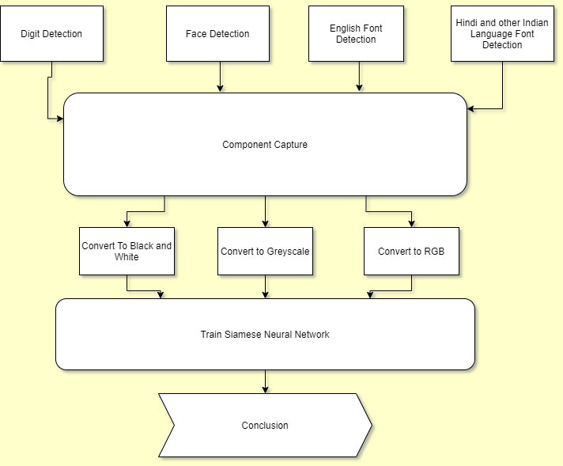
Architectural Diagram

Slide 13
Architectural Diagram
Digit Detection using the the Digit Detection harrcascades
Face Detection using the Face Detection Harrascade using the Face Detection Algorithm trained for only Gandhis face in Open CV.
English Font Detection is done using the same harrcascades for the font detection trained against font template in the Rs 100 note.
Hindi and other language font detection are done the same way as English font detection but changing the appropriate language font templates as standard RBI guidelines
Features are captured from the dataset of regular photos of the currency.
They are multiplied by adding filters like RGB, and Greyscale and Black and White filters and used as basic filters to train the Siamese Neural Network
The end-result of the trained model shows the detection accuracy with increasing epochs.

Slide 14
Modules Description
Face Detection :-
Face-detection algorithms focus on the detection of frontal human faces. It is analogous to image detection in which the image of a person is matched bit by bit.
A reliable face detection approach based on the genetic algorithm and the eigen-face technique
Trained Harrcascade detects the face of Gandhi for which it is trained.

Slide 15
Modules Description
Text Detection :-
The Text detection problem can be divided into 2 parts Digits identification and Text identification
Digit Localization is done using Maximally Stable Extremal Regions (MSER) method which serves as a stable feature detector
MSER has a lighter run-time complexity of O(nlog(log(n))) where n is the total number of pixels on the image and The algorithm is also robust to blur and scale.
This makes it a good candidate for extraction of text / digits.

Slide 16
Modules Description
Traditional Convoluted Neural Network :-
A Convolutional Neural Network is a Deep Learning algorithm which can take in an input image, assign importance (learnable weights and biases) to various aspects/objects in the image and be able to differentiate one from the other and also categorise the images.
The objective of the Convolution Operation is to extract the high-level features such as edges, from the input image.
Conventionally, the first Convolutional Layer is responsible for capturing the Low-Level features such as edges, colour, gradient orientation and with added layers the architecture adapts to the High-Level features.

Slide 17
Modules Description
Siamese Neural Network:-
Initially the whole currency note has been divided into features .
OpenCV detect the feature of the note by scaling down the normal full-scale image to 20 X 20 image. Live image detects the features from the note and have been stored in a repository.
Images are fed in to the SNN independently where a separate SNN for English font, a separate SNN for Hindi font, similarly for Gandhi’s face signature of the Governor and the colour-shade of one side of the note as well.
Minimum of 3 to 4 hrs to train.

Slide 18
Novelty in Methodology
In this project, we are trying to discard the fold and discoloration marks before checking the counterfeit note.
Earlier even the food stains or any text on notes were considered counterfeit which wont no longer be a problem using TensorFlow.
We are trying for greater efficiency rate.
Dividing the note into certain components such as the Hindi and English numeral or word on one side and the other and other patterns.

Slide 19
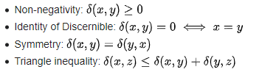
Equation, derivation and algorithms used.
Siamese Neural network uses triplet loss.
Baseline vector (anchor image) is compared against a positive vector (truthy image) and a negative vector (falsy image).
The negative vector will force learning in the network, while the positive vector will act like a regularizer.
The triplet loss algorithm is often defined with squared Euclidean distance at its core.
Some properties are :-

Slide 20

Equation, derivation and algorithms used.
Predefined metrics, Euclidean distance metric method
The common learning goal is to minimize a distance metric for similar objects and maximize for distinct ones. This gives a loss function like
i, j are indexes into a set of vectors.
f(.) function implemented by the twin network.
The most common distance metric used is Euclidean Distance, in case of which the loss function can be rewritten in matrix form as :-

Slide 21
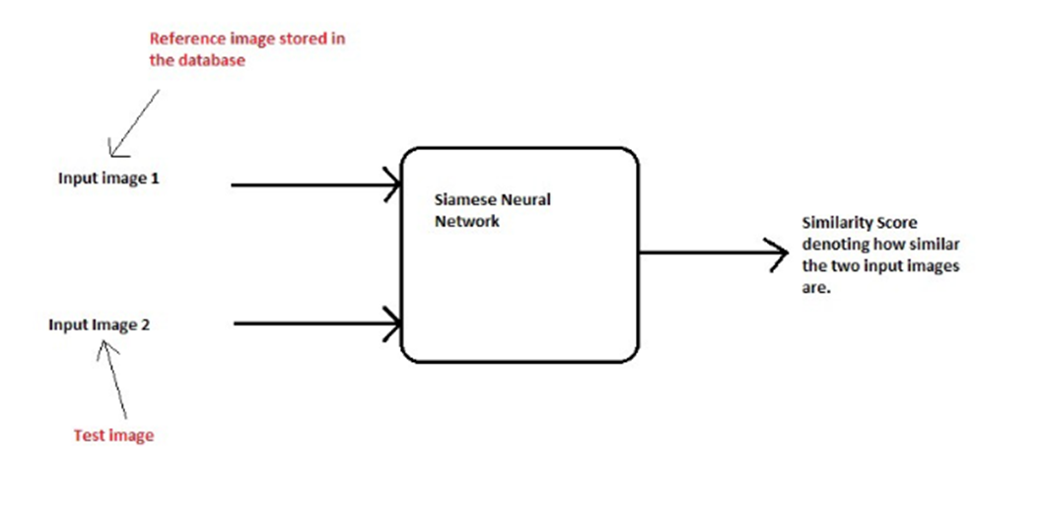
Equation, derivation and algorithms used.

Slide 22
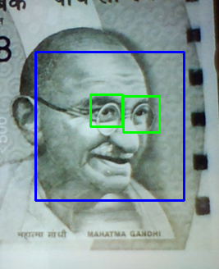
Screenshot of the Project
Eyes
Figure 1: Face Detection
Gandhi’s Face
Using OpenCV and Harrcascades the features of the Gandhi’s face is detected like eyes and smile from 500 Indian rupee.

Slide 23
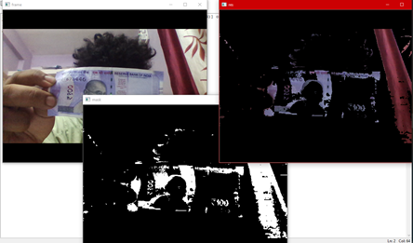
Screenshot of the Project
Normal Image
Gradient Filter
Figure 2: Color Gradient Filter
Boolean Filter
The above figure shows a color gradient filtering mechanism which captures live images and uses two filters.
The Boolean filter filters out exact shade or gradient hex value of the lavender color gradient of 100 rupee note which is fed into code and display it into white and the rest is black.
Any deviation from the actual shade will detect the counterfeit note.

Slide 24
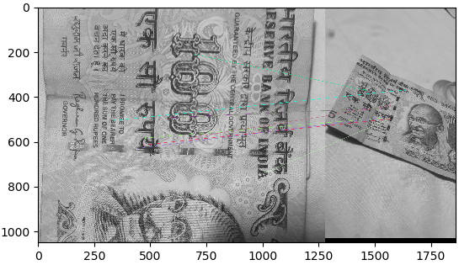
Screenshot of the Project
Feature Mapping Lines
Input Image
Figure 3: Feature Mapping
Random Image
Preliminary procedures to determine whether image placed in the right is at all a currency note. If features matching then only go for detailed analysis using Deep Learning.
Authentic Hundred Rupee has a high resolution image of the note in the left and low resolution and is taken at an angle with change in light exposure.
Compares and matches the features from the image in the left and connect them against the image on the right.

Slide 25
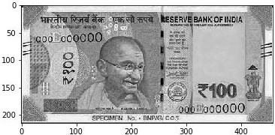
Screenshot of the Project
Figure 4: Training Images
400 x 200 high resolution. The second image is re-scaled to 50 x 50 medium resolution.
The higher the resolution the longer it takes for the model to learn and more compute power is demanded.
Re-scale it to a suitable value. Image does not become hard to learn by the model resulting in a bad training model. Just enough for the model to learn and use space and compute power efficiently.

Slide 26
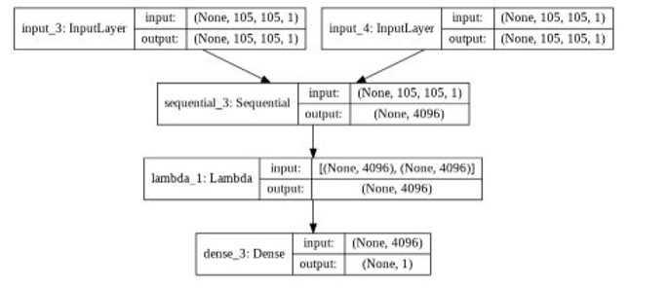
Screenshot of the Project
Figure 5: SNN Training Layers
Left input layer and the right input layer. The input and output shape is same for both layers.
Sequential Model which is the most method of handling multi-layer models then into a Lambda Layer which helps us define the function exclusively for the Siamese Neural Networks.
Dense Layer consisting of neurons which involve matrix vector multiplications.

Slide 27
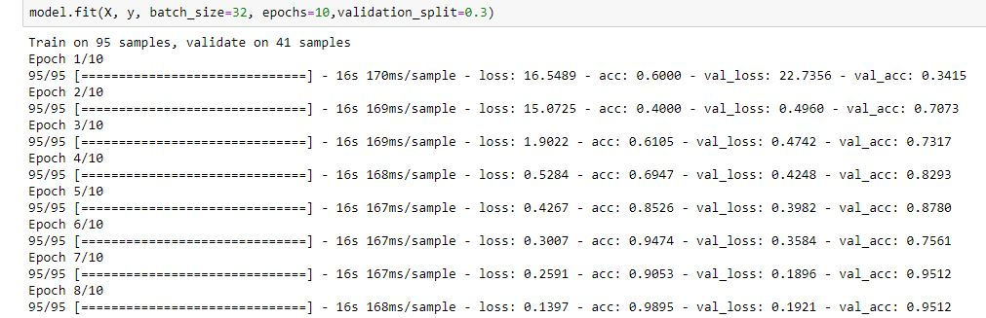
Screenshot of the Project

Slide 28
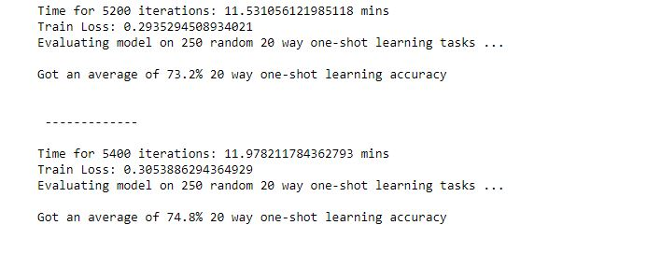
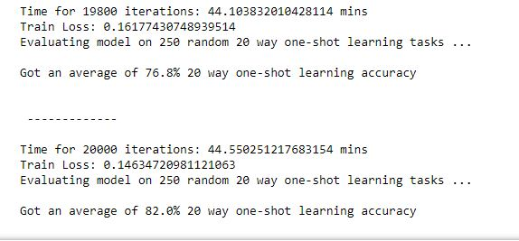
Screenshot of the Project

Slide 29
Results and Discussions
Data Sets :-
Diminish the size of the informational collection and abbreviate process time massively. The images in the dataset are being multiplied in many ways.
Rescaled into 50 x 50 size and being saved as a separate image.
White noise is being added to some of the images and saved separately using OpenCV.
Images have the same currency note taken at a different angle and amount of light falling on the note. Images have been digitally rotated at increments of very small angles to multiply the data set

Slide 30
Results and Discussions
In different models like KNN and random guessing having accuracy below 50 but the One-Shot Learning Tasks report accuracies above 90.
Compare the One-Shot Learning Tasks with Convoluted Neural Networks we are Looping the One-Shot learning tasks.
Gradual increments from 10 One-Shot Learning Tasks to 90 One Shot Learning Tasks.
Compute minimization with 50MB in One Shot Learning Tasks and 3GB in traditional CNN the overall efficiency of the One-Shot Learning Tasks is much better.

Slide 31
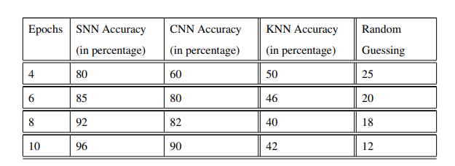
Results and Discussions
Table 1: Comparing the Efficiency Results Between CNN and SNN

Slide 32
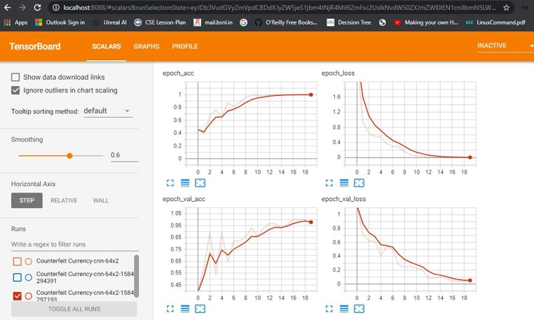
Results and Discussions
Figure 7: Plotting Accuracy and Loss

Slide 33
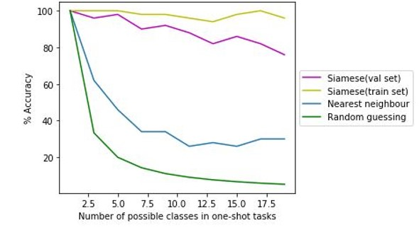
Results and Discussions
Figure 8: SNN vs Other Prediction Algorithms

Slide 34
References
[1] Tushar Agasti, Gajanan Burand, Pratik Wade and P Chitra,” Fake Currency Detection Using Image Processing,” IOP Conf. Series: Materials Science and Engineering 263 (2017) 052047 doi:10.1088/1757-899X/263/5/052047.
[2] F.Takeda, S. Omatu,T. Inoue, and S. Onami, "Bill Money Recognition Using Neural Network with FFT as Pre-processor, " Trans. on ISCIE of Japan, Vo1.5, No.7, pp.265-273, 2010.
[3] E.Haripriya, K. Anusdha, “Detection of Indian Countefeit Banknotes Using Neural Networks” Volume 04, Issue 12; December- 2018 [ISSN: 2455-1457].
[4] Ms. Monali Patil, Jayant Adhikari, Rajesh Babu, “Fake Currency Detection using Image Processing,” International Journal on Future Revolution in Computer Science Communication Engineering ISSN: 2454-4248 Volume: 4 Issue: 4(2017).

Slide 35
References
[5] Navya Krishna G, Sai Pooja G, Naga Sri Ram B, Yamini Radha V, Rajarajeswari P, “Recognition of Fake Currency Note using Convolutional Neural Networks,” International Journal of Innovative Technology and Exploring Engineering (IJITEE) ISSN: 2278-3075, Volume-8 Issue-5 March 2019”
[6] Angelo Frosini, Marco Gori, Member, IEEE, and Paolo Priami, “A Neural Network-Based Model for Paper Currency Recognition and Verification,” IEEE transactions on Neural Networks, Vol. I, No 6, November 2006.
[7] UtpalGarain, S. K Parui, T. Paquet, L. Heutte, “Machine Dating of Handwritten
Manuscripts,Vol. III, No 7, November 2009.”
[8] Hamid Hassanpour , Payam M. Farahabadi, “Using Hidden Markov Models for paper currency recognition”, Expert Systems with Applications 36 (2009) 10105–10111.

Slide 36
References
[9] Soo-Hyeon Lee and Hae-Yeoun Lee,” Counterfeit Currency Note Detection Using Deep Learning,” International Journal of Applied Engineering Research ISSN 0973-4562 Volume 13, Number 1 (2018) pp. 304-310.
[10] Murdoch, S.J Laurie,” Machine Assisted authentication of paper currency: An experiment on Indian Banknotes” IEEE Trans. Pattern Anal. Mach. Intell. 10(6), 978–983 (2008).
[11] N. Akamatsu, M. Fukumi, “A method to design a neural pattern recognition system by using a genetic algorithm with partial fitness and a deterministic mutation” 11(4), 922–984
(2009).
[12] A. Chowdhury, N. Jahangir, Bangladeshi banknote recognition by neural network with axis symmetrical masks in masks, in: 10th international conference on computer and information technology. IJTEE 2010.

Slide 37
References
[13] Da-costa, Multiview banknote recognition with component and shape analysis IJTEE 2014.
[14] S. Das, CNN Architectures: LeNet, AlexNet, VGG, GoogLeNet, ResNet and more, IJTEE 2017.
[15] P.R. Nagpure, T.Ghotkar, S. Shetty, Recognition and Fake Note Detection, International Journal of Innovative Research in Computer and Communication Engineering Vol 4 (March 2016).

Slide 38
Publication Details
Arunabha Mittra, Indranil Paul, S Sharanya “Counterfeit Currency Detection Using Resource Efficient Neural Networks” International Journal of Innovative Technology and Exploring Engineering (IJITEE) ISSN: 2278-3075, Volume-9 Issue-6, April 2020

Slide 39
Thank You

